Slide 1
Lesson objective
Title: Equivalent expressions
Aim:
Be able to identify equivalent expressions through substitution.
Plan:
Daily review
  Matching statements
  Substitution
Terminology
Odd one out

Slide 2
The word is
Pronumeral:
A letter or symbol used to represent a number.

Slide 3
The word is
Expression
Consists of numbers and pronumerals combined with any mathematical operations. (No equal sign)
When we do NOT know the value of the pronumeral, we cannot solve the expression… we leave the letter or symbol in
E.g., 2x + 6g – 9y + 12

Slide 4
The word is
Coefficient:
A number placed before a pronumeral.

Slide 5
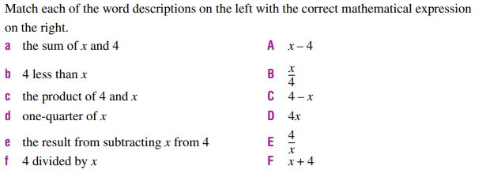
Review

Slide 6
Substitution
To evaluate an expression means to substitute (replace) the pronumeral (letter or symbol) with a number, then solve.
Example, if y = 6 and x = 10
X + y =
X – y =
2x + 3y =

Slide 7
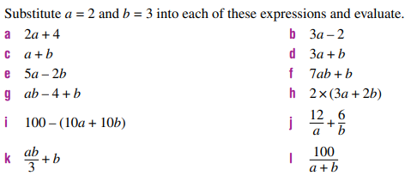
Substitution practice – exercise books

Slide 8
The word is
Equivalent
- Equal in value, amount or meaning

Slide 9
Equivalent expressions
Two expressions are called equivalent when they are always equal, regardless of what numbers are substituted for the pronumerals.
E.g., 4 + v and v + 4
Non example :
2v and v x v

Slide 10
Are they equivalent?
Are these expression equivalent?
2a + 6 a + a + 6
Why/why not?

Slide 11
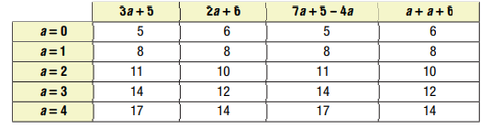
Choral response
Two expressions are called equivalent when they are always equal, regardless of what numbers are substituted for the pronumerals.
Which expressions are equivalent?
3a + 5
2a + 6
7a +5 - 4a
a + a + 6

Slide 12
Let’s try
If x = 3, what is x + 6?
If x = 3, what is 4x?
Is x + 6 and 4x equivalent?

Slide 13
We do
If a = 5, evaluate a + 4
If a = 5, Evaluate 2 + a + 2
Are they equivalent?

Slide 14
Practice
Page 213
Questions 5 – 12
If you finish early, have a go at question 13.

